Slide 1
Autonomous Vehicles Confused How Liability for Accidents Should Respond to Engineering Solutions for Adversarial Machine Learning
Steven Van Uytsel – Faculty of Law
Autonomous Vehicles and AI: A Question of Liability
October 25, 2021
Notes:
Thank words

Slide 2
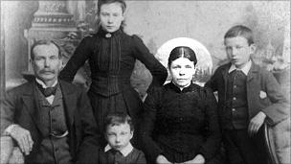
https://www.bbc.com/news/magazine-10987606

Slide 3
Bridget Driscoll
1896
First pedestrian fatality by a car

Slide 4
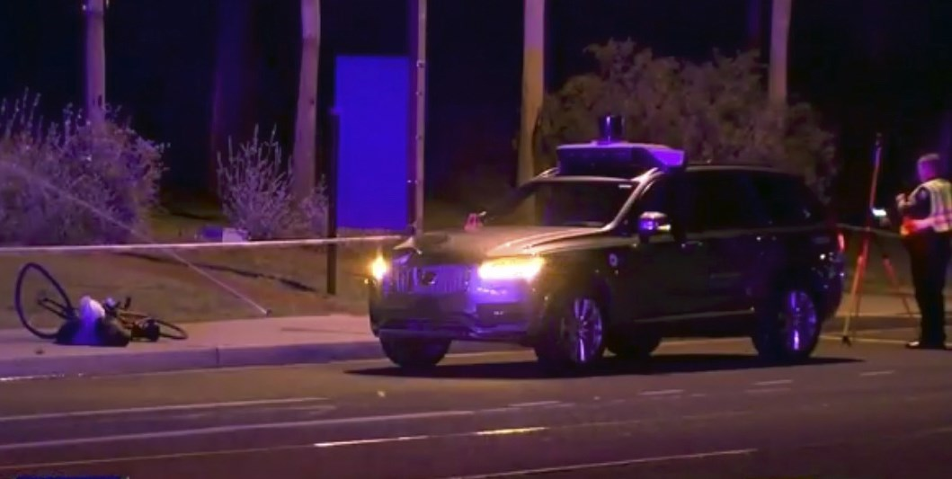
https://www.nbcnews.com/tech/innovation/self-driving-uber-car-involved-fatal-accident-arizona-n857941

Slide 5
Elaine Hertzberg
2018
First fatality by an autonomous (?) car

Slide 6
Accidents bring liability
My argument will be liability will remain important as an accident may still occur
However, I will posit that the vehicle will only be one element in autonomous driving
Why? Engineering responses to adversarial machine learning

Slide 7
Adversarial machine learning
Discipline that studies adversarial attacks on artificial intelligence
Adversarial attacks are changes (perturbations) made to ‘reality’ (e.g. a picture) by an adversary
These changes may or may not be visible to the human eye, but artificial intelligence will notice it when analyzing ‘reality’
The result is that the ‘secure system’ that is under attack will do something different than what it is intended to do

Slide 8
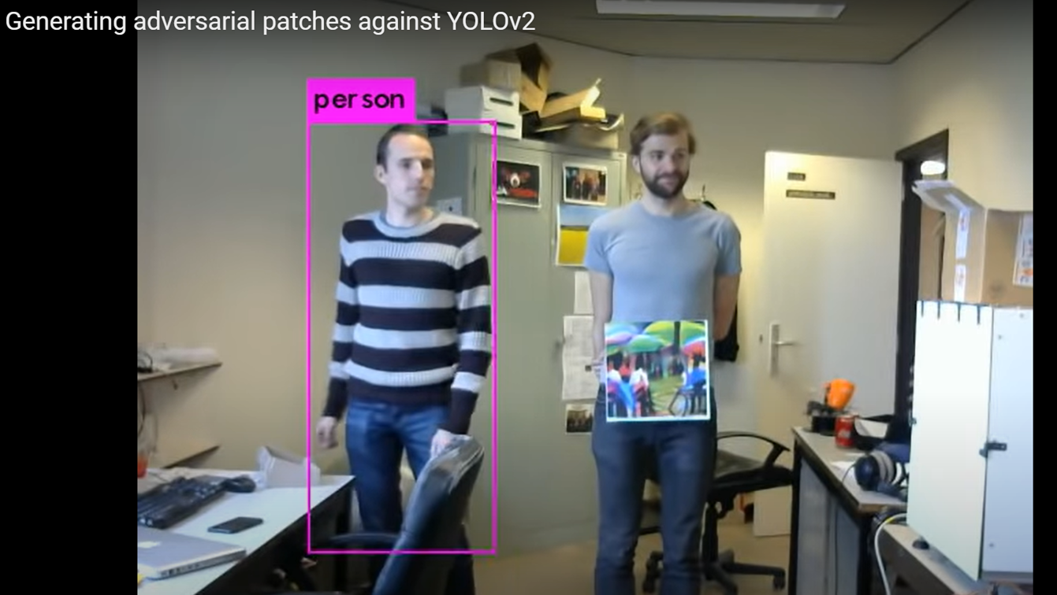
Making yourself invisible for AI cameras
https://nieuws.kuleuven.be/en/content/2019/ku-leuven-researchers-make-themselves-invisible-to-ai-cameras

Slide 9
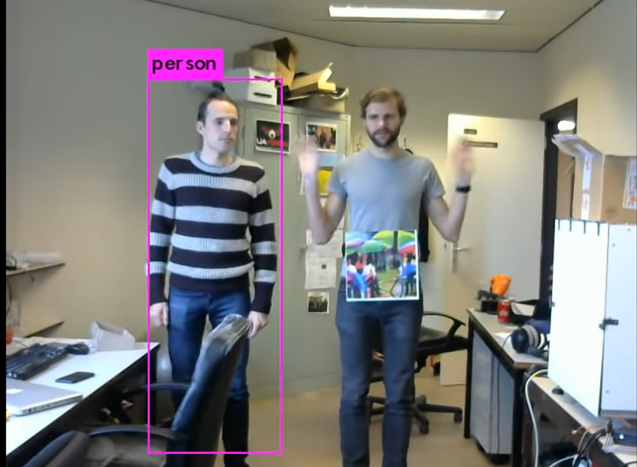
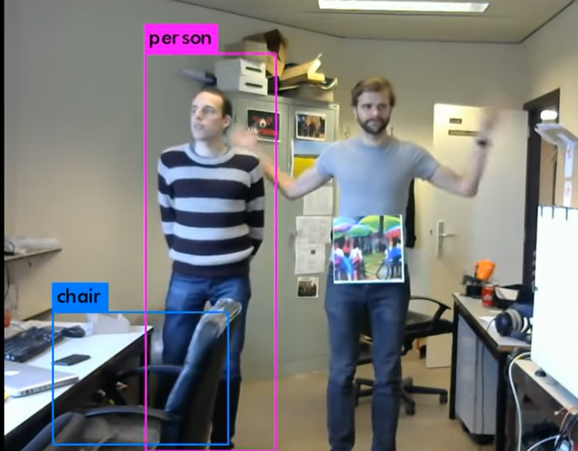
Attack through a picture: moving arms & both persons move

Slide 10
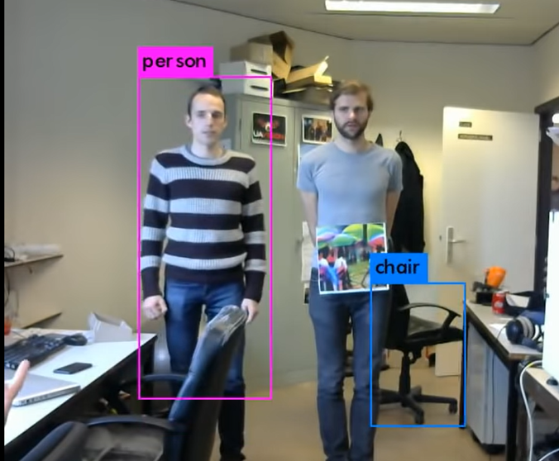
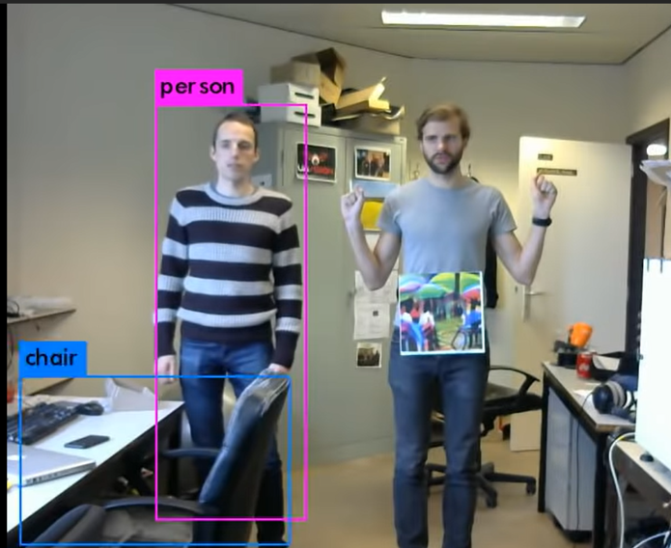
Attack through a picture: recognizing other objects

Slide 11
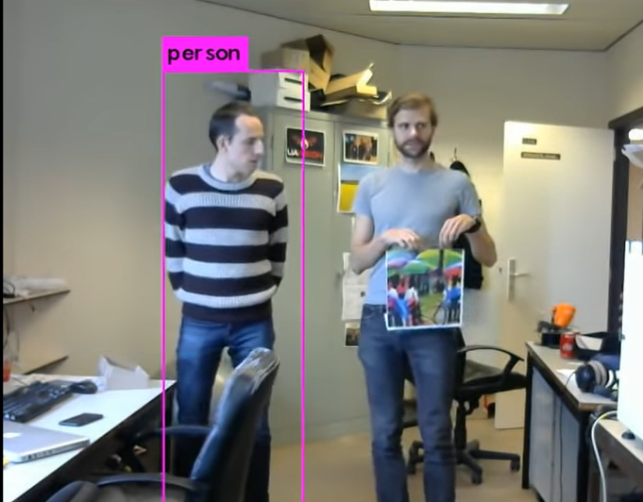
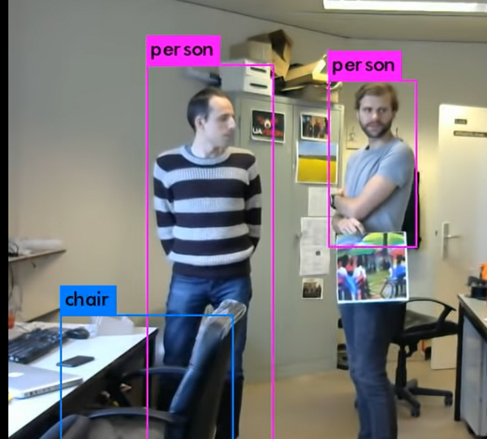
Adversarial attack through a picture: body taking a different angle

Slide 12
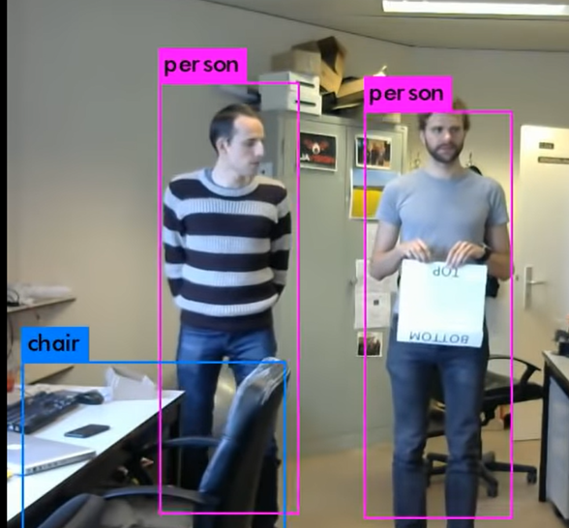
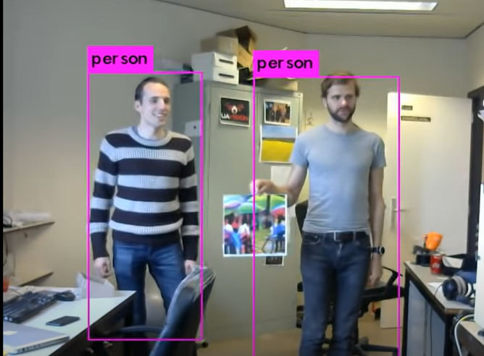
Adversarial attack through a picture: moving the picture

Slide 13
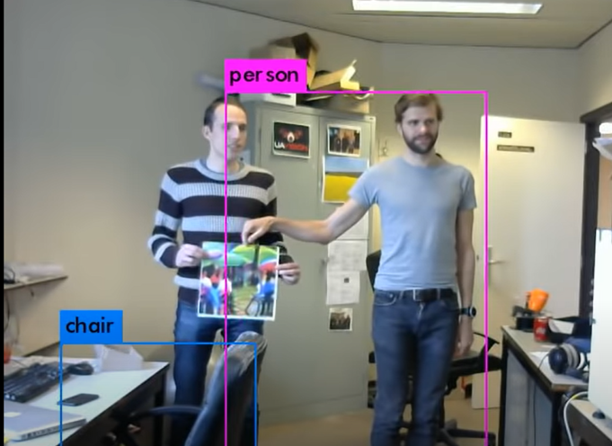
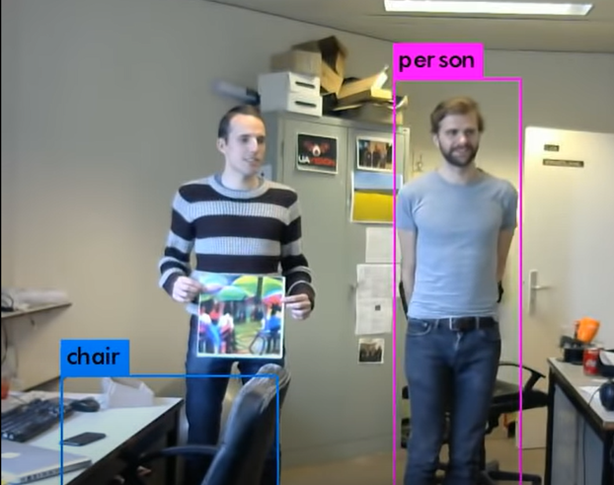
Adversarial attack through a picture: the other person disappears

Slide 14
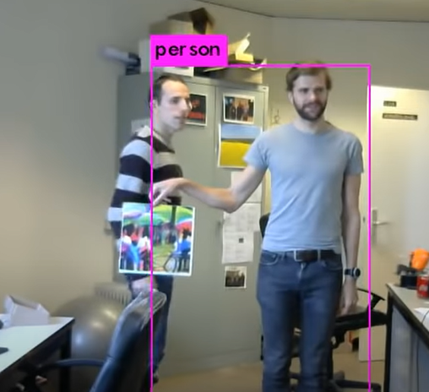
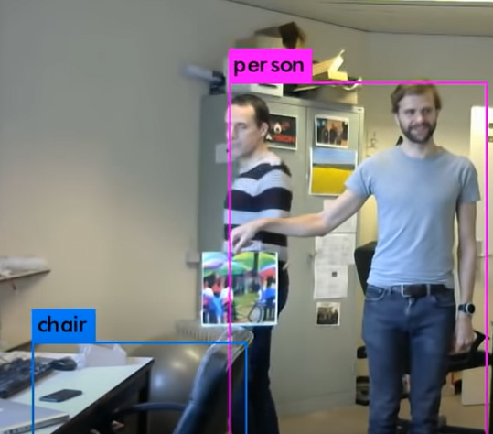
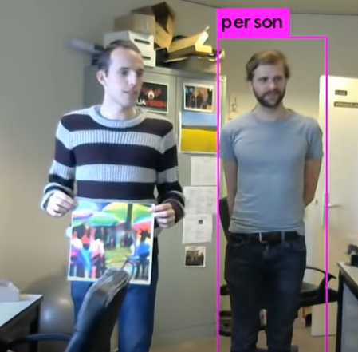
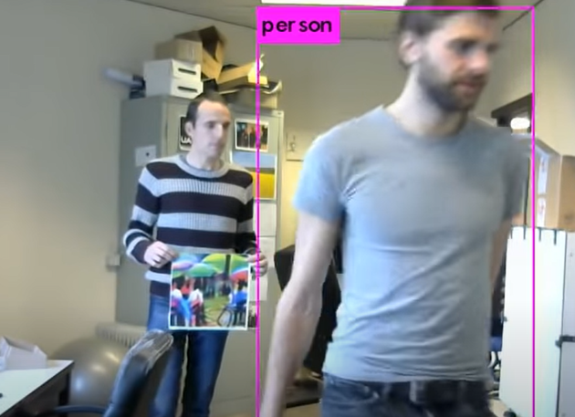
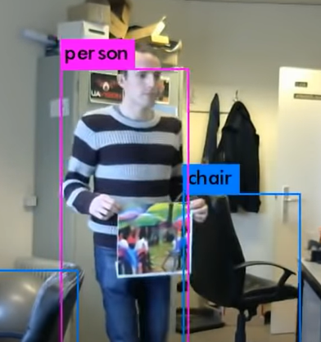
The experiment repeats itself

Slide 15
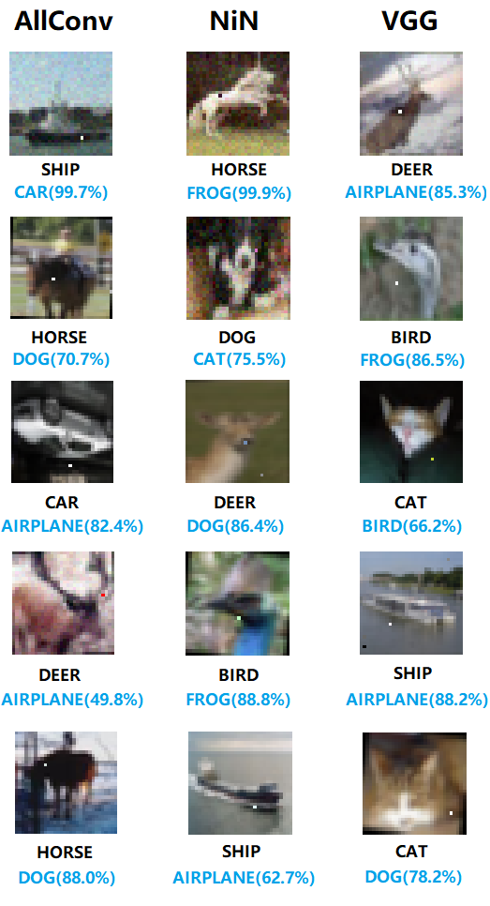
Linking adversarial machine learning with autonomous vehicles
Adversarial examples are inputs to machine learning models that an attacker has intentionally designed to cause the model to make a mistake
Su, J., Vargas, D. V., & Kouichi, S. (2017). One pixel attack for fooling deep neural networks. arXiv preprint arXiv:1710.08864.

Slide 16
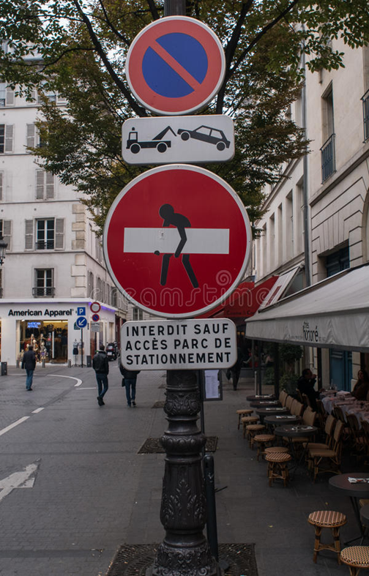
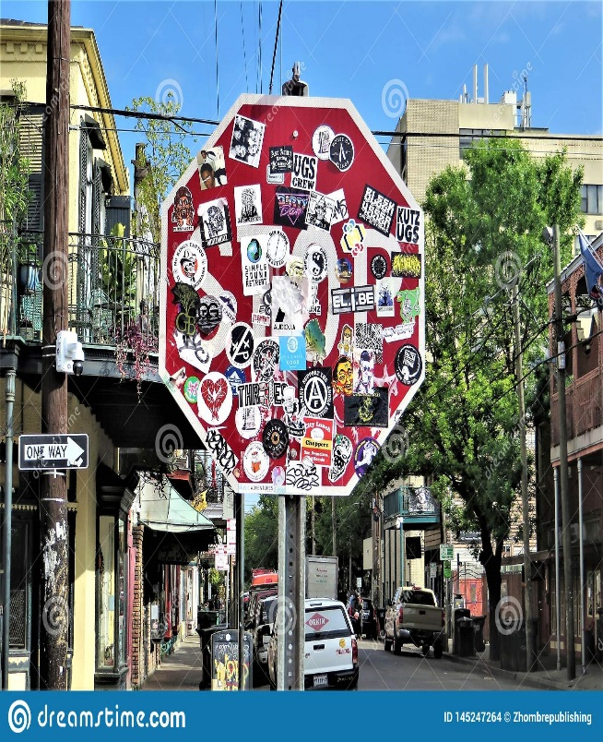
https://www.dreamstime.com/editorial-stock-photo-graffiti-traffic-signs-no-trespassing-sign-drawn-paris-street-image63131198
https://www.dreamstime.com/stop-sign-street-near-french-quarter-covered-stickers-advertisements-new-orleans-image145247264
Notes:
When looking at the pictures above, our human brain is able to recognize the original traffic sign, even though it has been altered either by painting a picture on the sign or by putting stickers on the sign. We all still recognize these signs as a sign forbidding passage or as a sign obliging us to stop respectively. For the neural networks, the alterations are the adversarial attacks on the picture they have learned. The result of these adversarial attacks may be that the neural networks do not recognize them anymore as the traffic signs they have originally learned. The signs may be interpreted as something completely different. Look at the next slide.
16

Slide 17
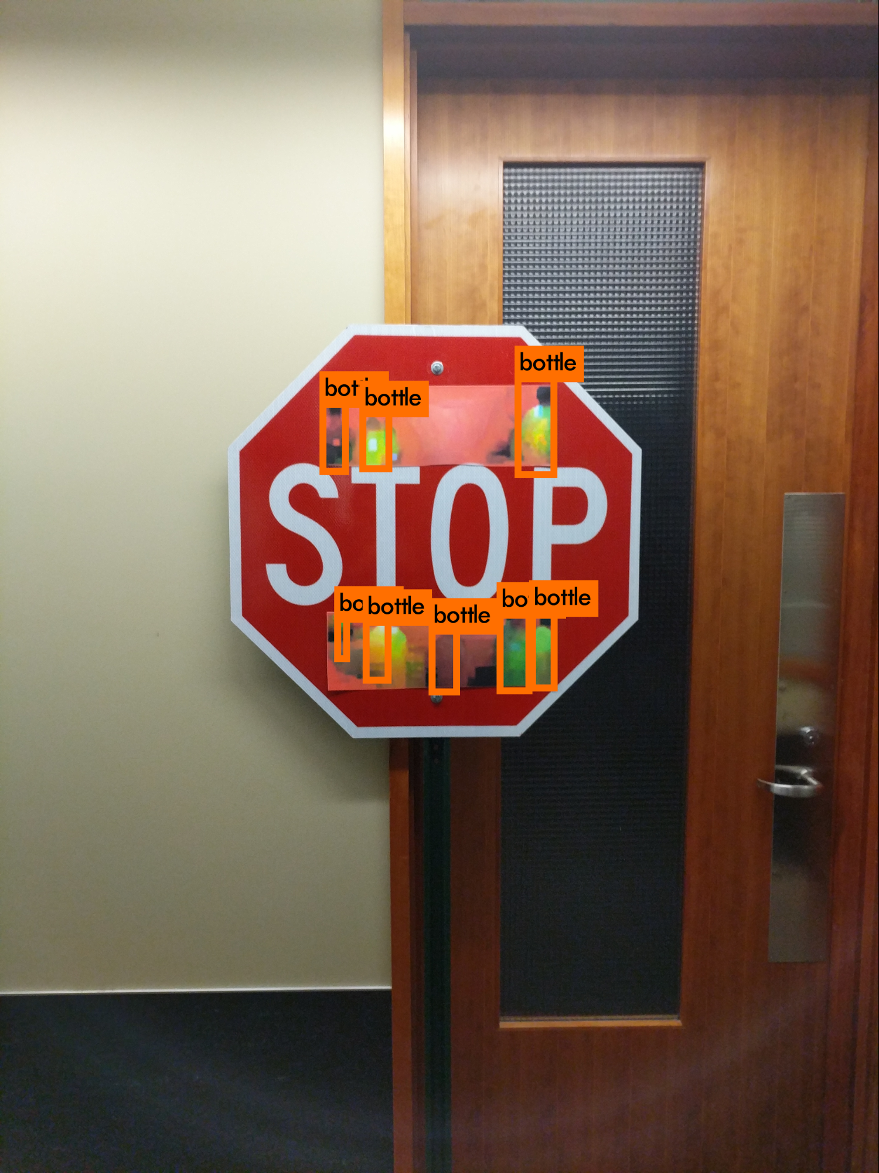
http://bair.berkeley.edu/blog/2017/12/30/yolo-attack/
Notes:
This is another example, where the AI recognizes bottles instead of a stop sign. We demonstrate physical adversarial examples against the YOLO detector, a popular state-of-the-art algorithm with good real-time performance. Our examples take the form of sticker perturbations that we apply to a real STOP sign. The following image shows our example physical adversarial perturbation. NOT perceiving the stop sign.
17

Slide 18
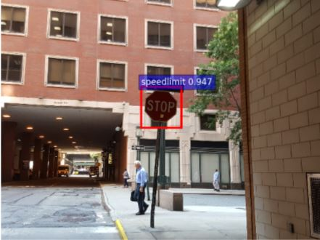
https://workplacetablet.com/2017/12/18/making-self-driving-cars-hallucinate/

Slide 19
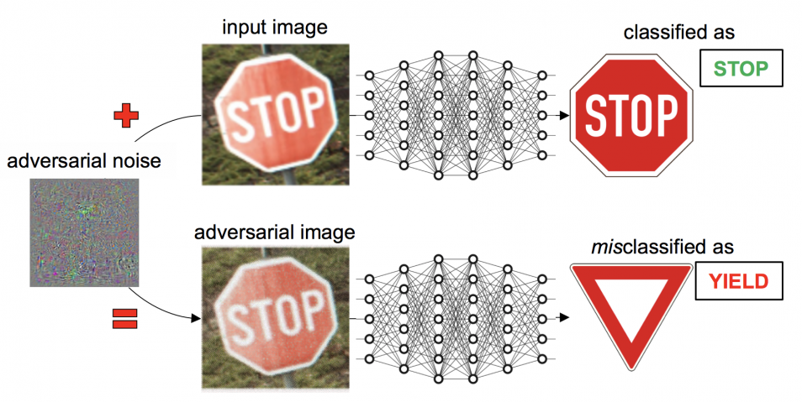
https://blog.csiro.au/vaccinating-machine-learning-against-attacks/
http://www.wildml.com/2015/11/understanding-convolutional-neural-networks-for-nlp/

Slide 20
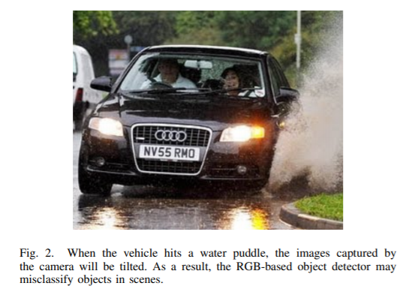
Source: https://arxiv.org/pdf/1907.05274.pdf： By Liu Letao, Martin Saerbeck, and Justin Dauwels
Notes:
The stop sign has just been altered with a yellow sticker (placed where the yellow arrow stops). The alteration is fairly small. This tiny small alteration caused the neural network to think that the traffic sign was not a STOP sign anymore, but a SPEED LIMITATION sign. Look at the blue box, there it is indicated how the
20

Slide 21
The Edge Cases
Cases you do not expect to be a problem for ML
Very often at unpredictable for a human

Slide 22
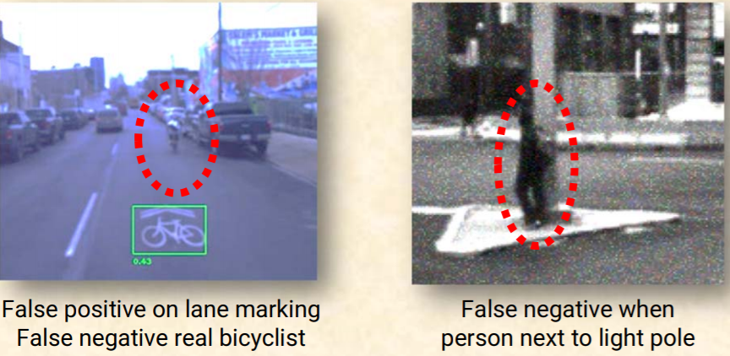
http://users.ece.cmu.edu/~koopman/lectures/Koopman19_SSS_slides.pdf

Slide 23
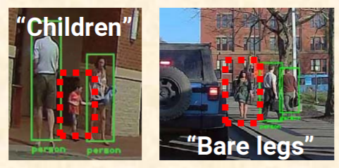
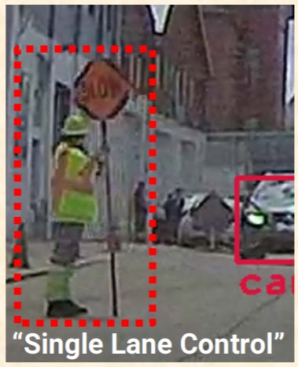
http://users.ece.cmu.edu/~koopman/lectures/Koopman19_SSS_slides.pdf

Slide 24
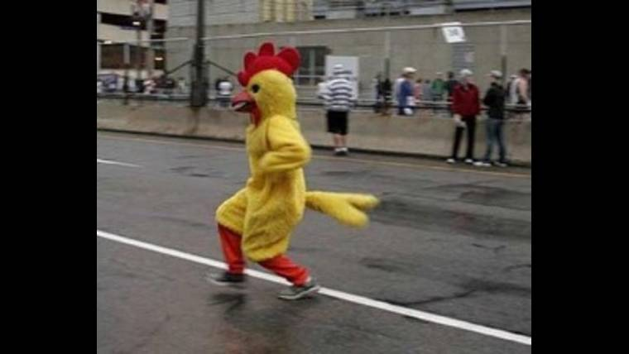
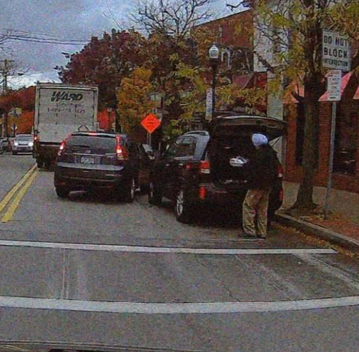
http://users.ece.cmu.edu/~koopman/lectures/Koopman19_SSS_slides.pdf

Slide 25
Accidents with autonomous vehicles
Leaving aside accidents caused by
* human behavior
- other participants in traffic (sudden movements)
- vehicle outside the Operational Design Domain (driving in bad weather, not cleaning sensors, …)
- failure to update software
* mechanical breakdown of the vehicle
And focusing on the failure of the artificial intelligence (AI)

Slide 26
An immediate legal response: operator liability
Human defined as operator
the one engaging the vehicle
the one sitting at the driver seat
the one that pushes the start button
the owner of the vehicle

Slide 27
Rethinking the legal response
Is it fair to look at the ‘human’ operator to request compensation?
SAE level 3 vehicle – human drive when request to regain control
SAE level 4 or above vehicle - human has no role to play

Slide 28
If no, what are the alternatives?
Product Liability Law
questions: 1) is AI a product? 2) When is AI defective?
problems: lengthy trials?
Negligence
questions: 1) what is the standard of care?
problem: lengthy trial?
No-fault Liability
questions re: organization: 1) insurer, 2) insurance taker
problem: willingness of the insurance sector to change

Slide 29
An engineering response
Solve the problem of adversarial machine learning
Better definition of the operational design domain (ODD)
Safety by design: connectivity

Slide 30
Correcting adversarial machine learning

Slide 31
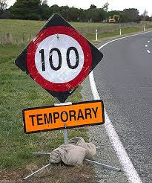
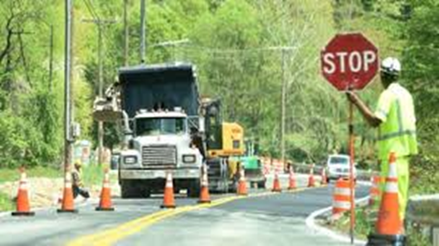
Unexpected changes to ODD

Slide 32
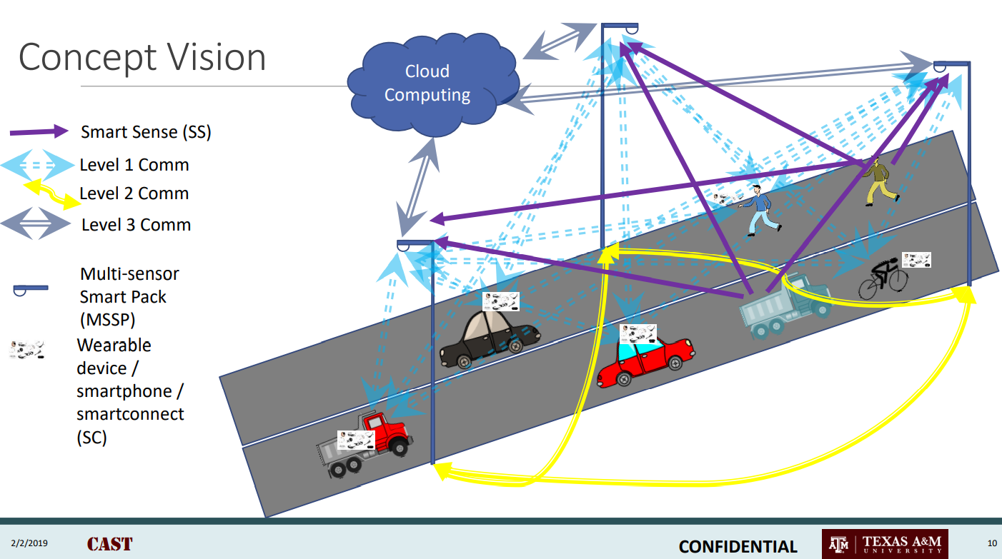
Connectivity
Source: Swaminathan Gopalswamy

Slide 33
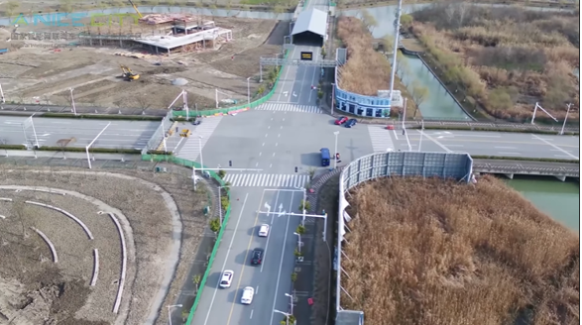
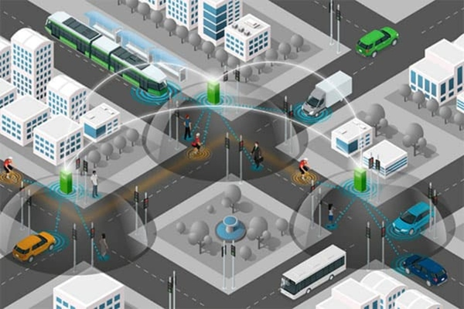
Connectivity: AIMES, CAST, A Nice City, etc.
A Nice City
Australian Integrated Multimodal
EcoSystem
CONNECTED AUTONOMOUS SAFE TECHNOLOGIES

Slide 34
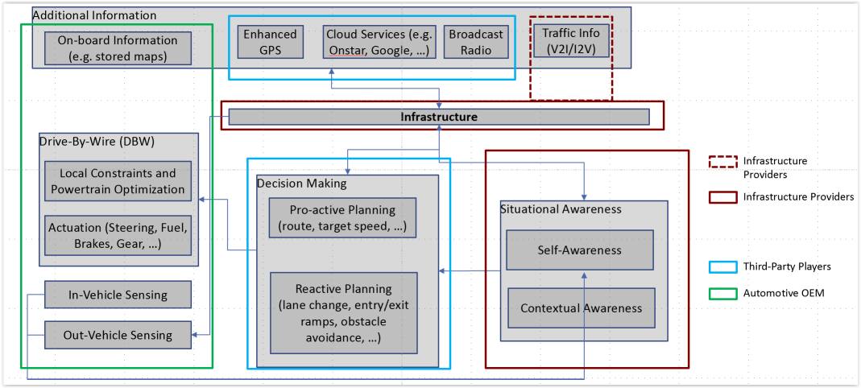
CONNECTED AUTONOMOUS SAFE TECHNOLOGIES: Infrastructure Enabled Autonomy
Source: Swaminathan Gopalswamy

Slide 35
Implications for liability for accidents
Infrastructure enabled automotive driving
increase of actors: OEM’s of vehicles, infrastructure providers, cloud service providers, road maintenance service
services offered besides products
=> complex web of potential defendants for a victim of a traffic accident to sue and this potentially on different liability systems (negligence or defect)

Slide 36
Complexity for the victim an argument for a no-fault compensation scheme?

Slide 37
Moving in the direction of a no-fault compensation scheme?
Volvo CEO
publicly indicated that they want to take responsibility for accidents with their self-driving vehicles irrespective of fault
Internalization of the costs of the accidents
manufacturers prevent negative publicity
manufacturers prevent unpredictable court decisions
(partly selfish – if a victim is not able to get compensation – trust in autonomous vehicles will disappear)

Slide 38
Conceptualization of a no-fault compensation scheme
Different formats
insurance taker – possessor of vehicle, manufacturer, both, or any other person that may be justifiable in the future, etc.
insurer – state, third-party private insurance company, car manufacturer, etc.
Adjust the format according to the aims
compensation – easy compensation to victims
prevention of accidents – make manufacturers contribute to the fund
tort law could remain an option if not choose for the fund

Slide 39
Conclusion
Liability rules traditionally applied to accidents with cars (vehicles) may be applied to autonomous vehicles
However, we may need to rethink the liability rules for autonomous vehicles
*think of a victim that has to receive a smooth compensation
*think of deterring OEMs from releasing faulty products
This may be amplified if autonomous driving is being realized through infrastructure enabled autonomy?

